Slide 1
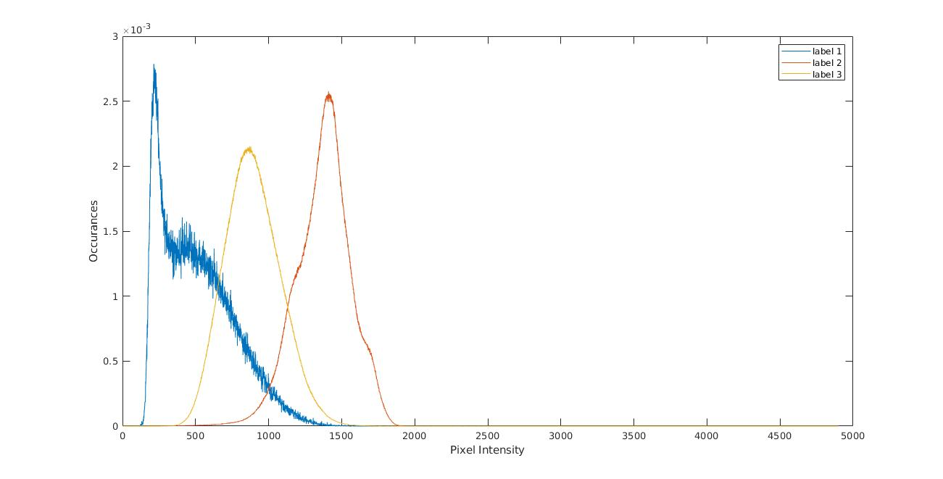
Histogram
Probability of Occurrence of Labels given intensity value

Slide 2
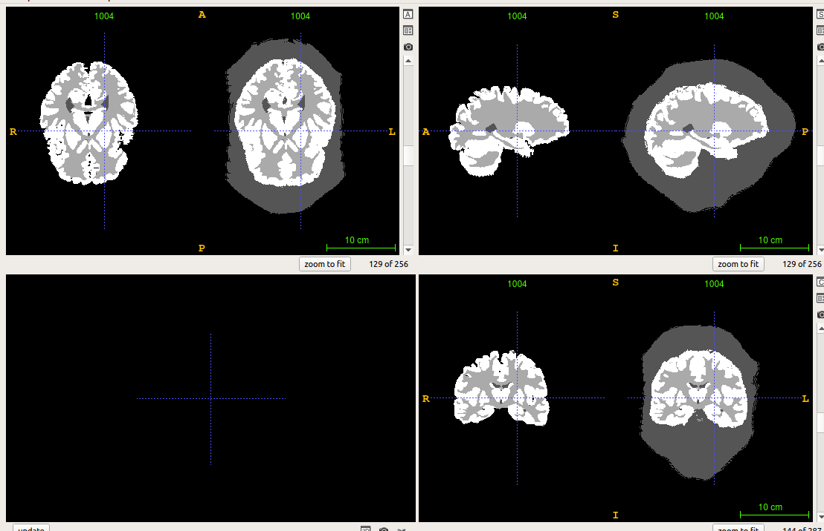
Masking VS Without

Slide 3
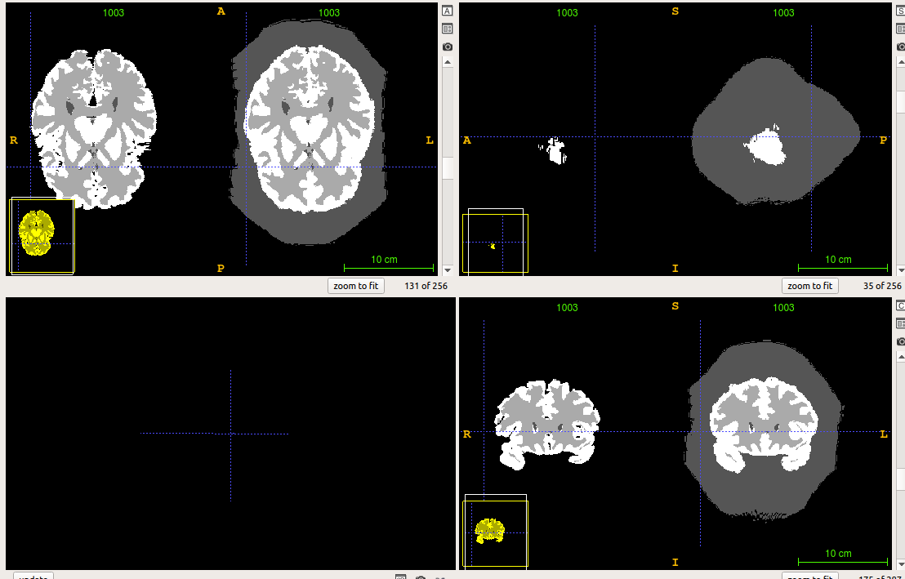
Another Example

Slide 4
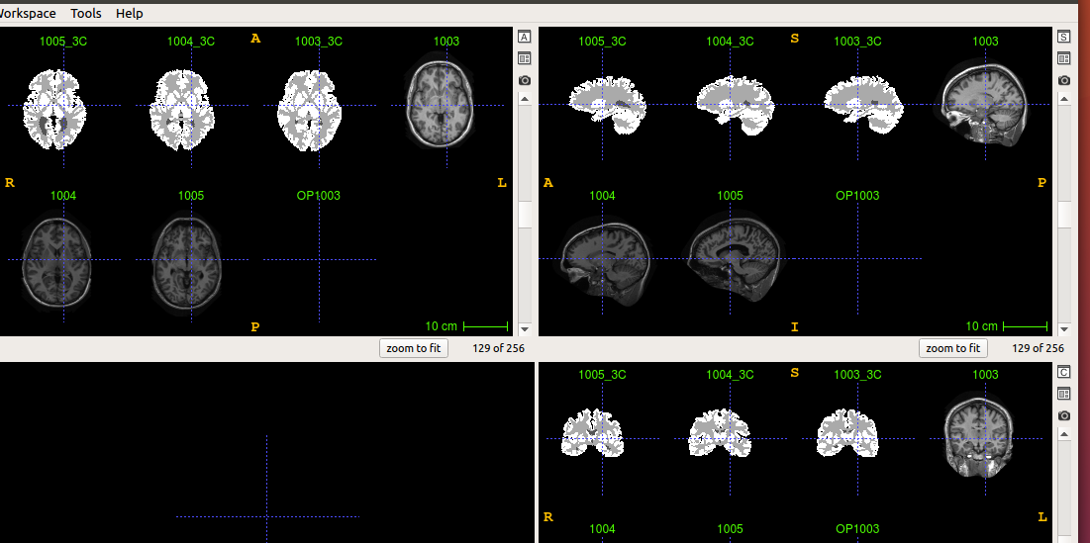
Images and Labels

Slide 5
For Image 1003
 | Label 1 | Label 2 | Label 3
Jaccard | 0.56 | 0.79 | 0.66
Dice | 0.72 | 0.88 | 0.80
False Positive Ratio | 0.35 | 0.24 | 0.11
Specificity | 0.65 | 0.76 | 0.89
False Negative Ratio | 0.24 | 0.02 | 0.27
Sensitivity | 0.76 | 0.98 | 0.73

Slide 6
 | Label 1 | Label 2 | Label 3
Jaccard | 0.63 | 0.85 | 0.73
Dice | 0.77 | 0.92 | 0.85
False Positive Ratio | 0.47 | 0.06 | 0.18
Specificity | 0.53 | 0.94 | 0.82
False Negative Ratio | 0.08 | 0.10 | 0.13
Sensitivity | 0.92 | 0.90 | 0.87

Slide 7
 | Label 1 | Label 2 | Label 3
Jaccard | 0.60 | 0.82 | 0.72
Dice | 0.75 | 0.90 | 0.84
False Positive Ratio | 0.23 | 0.11 | 0.20
Specificity | 0.77 | 0.89 | 0.80
False Negative Ratio | 0.26 | 0.09 | 0.12
Sensitivity | 0.74 | 0.91 | 0.88

Slide 8
Average
 | Label 1 | Label 2 | Label 3
Jaccard | 0.60 | 0.82 | 0.70
Dice | 0.75 | 0.90 | 0.83
False Positive Ratio | 0.35 | 0.14 | 0.16
Specificity | 0.65 | 0.86 | 0.84
False Negative Ratio | 0.19 | 0.07 | 0.17
Sensitivity | 0.81 | 0.93 | 0.83
Time taken when run on an i7, 7th generation processor
To build the Atlas is 84mins
To build the label image 33 sec

Slide 9
Problems
Python instead Bat file
Registering Labels
ITK Snap visualization
Creating dictionary for histogram mapping
Saving the file in SimpleITK
Using without Mask

